Slide 1
TERMS – BODY POSITION AND MOVEMENTS
TIME TO TALK LIKE A DOCTOR

Slide 2
POINTS OF REFERENCE
Superior
Inferior
Anterior
Posterior
Medial
Lateral
Proximal
Distal

Slide 3
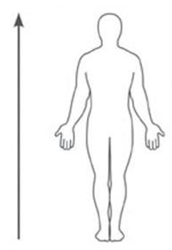
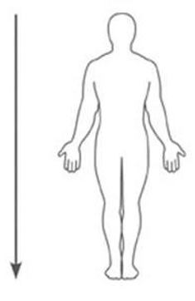
Superior Vs Inferior

Slide 4
Anterior Vs Posterior

Slide 5
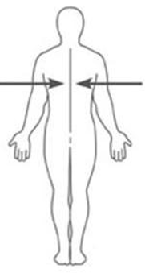
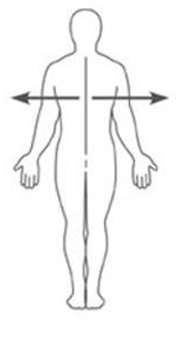
Medial Vs Lateral

Slide 6
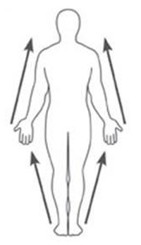
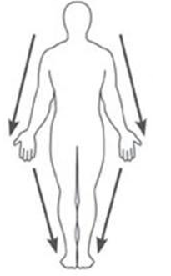
Proximal Vs Distal

Slide 7
Body movements
Flexion
Extension
Plantarflexion
Dorsiflexion
Abduction
Adduction
External rotation
Internal rotation
Supination
Pronation

Slide 8
Flexion – is when two bones come closer together

Slide 9
Extension – is where two bones go further apart

Slide 10
Plantarflexion – OCCURS ONLY AT THE ANKLE - IS POINTING THE TOES DOWNWARDS

Slide 11
DORSIFLEXION – OCCURS AT THE ANKLE - INVOLVES PULLING THE TOES UP

Slide 12
Abduction – moving a joint away from the mid-line of the body

Slide 13
Adduction – bring a limb closer to the midline of the body

Slide 14
External rotation – when the limb rotated away from the midline of the body

Slide 15
External rotation of the arm – rotated away from the midline of the body

Slide 16
Internal Rotation – when the limb is rotated toward the midline of the body

Slide 17
Very fast internal rotation of the arm!

Slide 18
Supination and pronation of the foot – an abnormal weight load on either the outside (supinated) or pronated (inside of the foot)

Slide 19
Check your Own shoes – is there any supination or pronation wear?

Slide 20
Pronation – corrected with orthotic

Slide 21
Ankle eversion – making the ankle go out (or away) from the midline of the body

Slide 22
Ankle inversion – making the ankle come toward the midline of the body

Slide 23
HSS 1010 Booklet
Anatomical Movement Matching
Anatomical Movements
Anatomical Directions/Planes

